Slide 1
CAD with Fusion 360

Slide 2
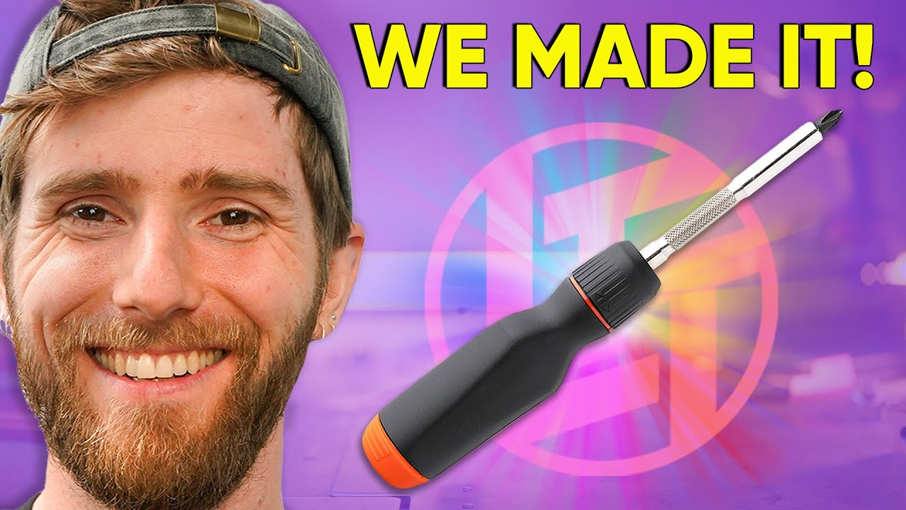
Product design process
Some steps to design a product?
Get an idea of what we want to make
Rapid prototyping
Taking into account manufacturing process
Usability testing
Refine
Like super super refine
A lot of troubleshooting
A good video to watch: Linus Tech Tips - Why our Screwdriver took 3 YEARS

Slide 3
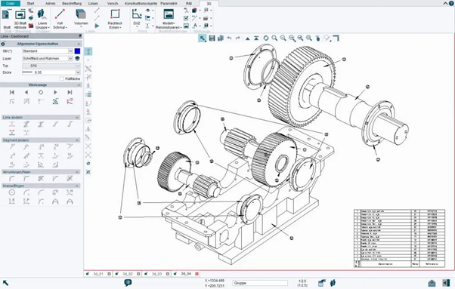
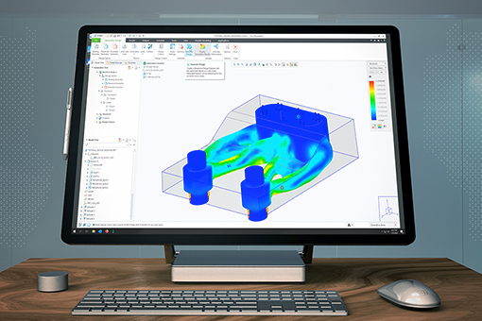
What is CAD?
Notes:
Try and engage audience by asking them to chime in here with what they think CAD is

Slide 4
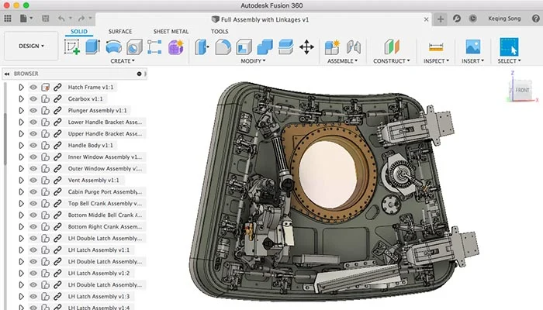
Get to know Fusion 360
Notes:
Let members play around with it, get to know the app

